Slide 1
THORN SCRUB FOREST
-YAVANICKA

Slide 2
DECCAN THORN SCRUB FOREST
The Deccan thorn scrub forest are a xeric shrubland ecoregion of south India and northern Sri Lanka. Historically this area was covered by tropical dry deciduous forest, but this only remains in isolated fragments. The vegetation now consist of mainly southern tropical thorn scrub type forest. There are a number of small protected areas which provide a haven for the wildlife.

Slide 3
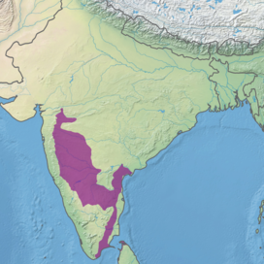
characteristics of scrub forest
The common animals of thorn forest and scrub are rats, mice, rabbits, fox, wolf, tiger, lion, horses and camels. There are almost 350 bird species recorded here Tropical thorn forest covering 16,491 square kilometres. In India, tropical thorn forests are found in southwest Punjab, Haryana, Rajasthan, Gujarat, Madhya Pradesh, and Uttar Pradesh, among other places.

Slide 4
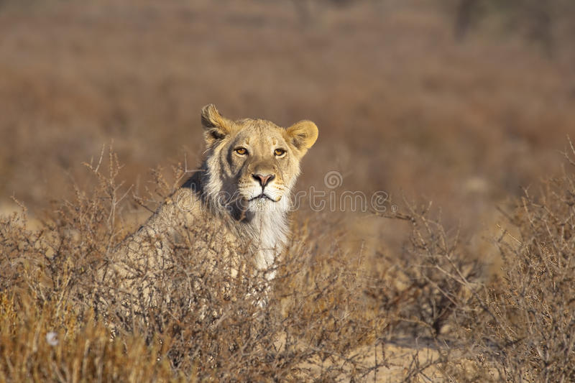
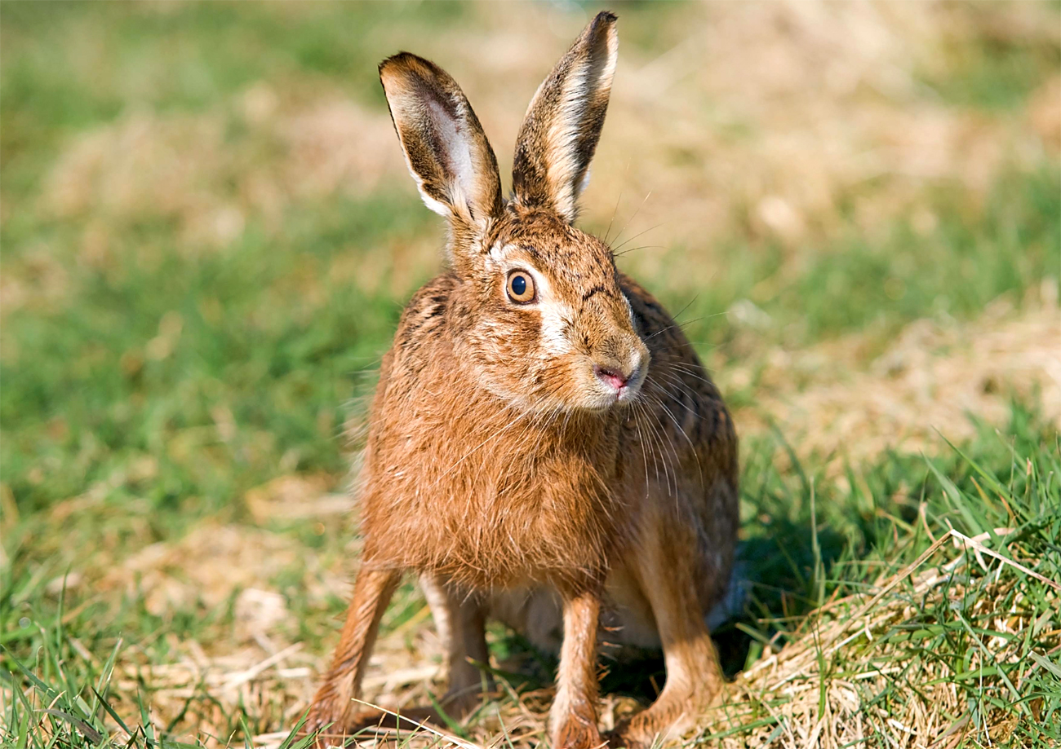
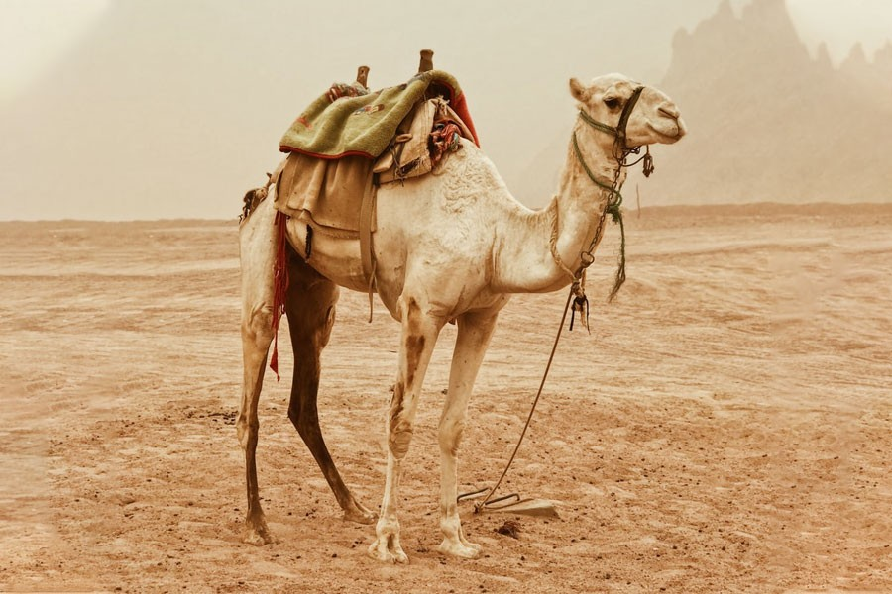

Slide 5
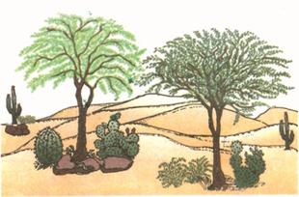
In regions with less than 70 cm of rainfall, the natural vegetation consists of thorny trees and bushes. This type of vegetation is found in the north-western part of the country. Trees are scattered and have long roots deep into the soil in order to get moisture. the stems are succulent to conserve water.

Slide 6
Thank you

